Slide 1
CHAPTER-TWO 2. Understanding State & Government
At the end of this class students be able to:
Identify the different definitions of state, its historical development and elements of state
Understand the difference between society and state
Analyzes the three types of state structure in the world: Major characteristics, and their advantages and disadvantages
Understand the division of power in federal state structure
Describes what government is and its function
Recognizes the organs of government and its functions
Analyzes the types of government: parliament and presidential
Understand the differences between state and government

Slide 2
2.1. Definition and Characteristics of Society
The term society is derived from a Latin word socius.
Socius means :-
association, togetherness, living in group, group life.
2. 1.1. Elements of Society
Common Geographical area/defined territory
society is usually a relatively large grouping of people in terms of size.
Have Common Culture: language, identity,
Have the feeling of identity and belongingness.
A society is autonomous and independent

Slide 3
2.2. Defining and Understanding of State
2.2.1. Conceptual Discourses
It is significant that though some sort of political organizations has existed since ancient times, such as Greek city-states and the Roman empire, yet the concept of the ‘state’ as such is comparatively modern.
It is the product of the sixteenth century, although it existed in some crude form long before Nicole Machiavelli imparted it a scientific meaning.
Thus the Greeks used the term ‘Polis’ for the City-State. The Romans used the term ‘Civiles’ to designate a body politic.
It is politically organized society.
Different political philosophers define state differently. Some of these Definitions are as follows:

Slide 4
Aristotle define state as“ a union of families and villages having for its end a perfect and self sufficing life”.
Woodrow Wilson defines it as “people organized for law within a definite territory”.
According to Garner State is A “Community of persons more or less numerous permanently occupying a definite portion of territory, independent or nearly so of external control and having an organized government to which the great body of inhabitants render habitual obedience”.
According to Laski State is “ territorial society divided into government and subjects who relations are determined by the exercise of the supreme coercive power”
For social contract Theorists like, Hobbes, Locke and Rousseau state is the result of purposeful creation by the peoples for their convenience and utility.

Slide 5
Major Elements of State
‘Pillars’ of the modern state are
STATE
People
Gov’t
Sovereignty
Territory

Slide 6
i. People
State is not create without peoples.
The question is how much people constitute state?
Size (It cannot be fixed) i.e. There is no standard with regard to the number of people in a state.
ii. Sovereignty
It is supreme power/authority of the State to make any decision regarding with internal and external matters of the country.
It is internal supremacy and external independence.
It is free to make its own foreign policy decision without any external pressure.

Slide 7
iii. Territory
There can be no state without a fixed territory.
People need territory to live and organize themselves socially and politically.
Territory is necessary for citizenship.
Territory of the state includes land, water and air-space.
The size, location and shape of a state do not put impact for its survival, yet it may have an impact on its development and security.
iv. Government
It’s the political organization of the state.
There can be no state without government.
It is the working agency of state that responsible for the overall administrative affairs of the country.

Slide 8
v. Recognition:-
An external acceptance of a newly emerging independent state by other states in the world is called International recognition.
Recognition is a political act; to mean it depends on the interest of a recognizing state.
It is not compulsory element.
State can exist without getting international recognition.
It is supplementary element of the state.
It is very important to be recognized, but it cannot determine the legal existence of a given state in this real world.

Slide 9
2.2.2. Origin and Historical Development of State
A. Genetic or Natural or Evolutionary Theory
State gradually and slowly evolved out of earlier forms of settled human communities, such as the family, the clan and tribe.
Aristotle says “state is the product of the natural or gradual expansion of the family”.
The first group of collective human life is the family or the household, the last is the state.
State
Family
Tribe
Community
Society

Slide 10
B. Theory of Divine Origin
The State, is advocates maintain was created by God and governed by his deputy or vicegerent.
The ruler was a divinely appointed agent and he was responsible for his action to God alone.
some are born to rule while others are born to be ruled
Power is Hereditary,
As ruler was the deputy of God, obedience to him was held to be a religious duty and Resistance to lawful king is sin.
C. Force Theory
State is created by the use of physical force.
Through the process of conquest, subjugation and coercion of the weak by the strong.
The state is born out of force.
Exist in force and die in the absence of force.
Military strength or physical strength has paramount importance for consolidation of state.

Slide 11
D. The Social Contract Theory
It postulates a state of nature as the original conditions making and a social contract.
State is the results of consent (will) of the people.
The main purpose of such state is to protect and safeguard the inalienable rights of the people such as the right to life, liberty, and property.
This theory argued that state is an artificial creation based on the contract or agreement the people at large.
E. The Marxist View
State evolved gradually and steadily as a result of disappearance of primitive communities.
The formation of social classes is associated with emergence of private property.
State originated from the split of society into social classes.
The formation of socio-Economic paved the way for foundation of state.

Slide 12
2.3. The Differences between Society and State
No | State | Society
 | State came into existence after the origin of the society. | Society is prior to the state.
2 | The state exists for the society as a means for its end | Society is an end by itself
3 | An artificial institution-it was made when it was needed | A natural and an innate institution
4 | State is not broader and narrower. Or State has fixed territory. | Society is both broader and narrower than the State. Or Society has no fixed territory.
5. | State is a political organization. | Society is a social organization.

Slide 13
2.4. State structure
There are many states in the world.
States can also be differentiated by the structures of government they have.
The are three state structure in the world.
Unitary state Structure
Federal state structure
Confederal state structure
The criteria to categorized these:-
Power division/ degree of power shared/ between the central government and regional government.

Slide 14
Major characteristics of Unitary State Structure | Major characteristics Federal State Structure
Centralization of power Indivisible of power | Decentralization of power Devolution of power
The central government has full legal right to over-rule Local governments. The right to make decisions on all political matters rests with the national government | Both the center and regions have certain independent spheres of authority to make decisions independently of each other. There is self rule and shared rule. It is agreement of two (or more) levels of government /political entity. There are formal division of powers between two levels of government.
There is no self rule and shared rule All administrative policies and principles originate only from the center.

Slide 15
Major characteristics Unitary State structure | Major characteristics Federal State Structure
Allocated powers by the central government There is one constitution There is only one legislator The regional or local units are highly subordinated or subservient to only the will of the national government. The local governments are created by the center, their existence is depend the interests of the central government and they are subordinate to the national Government | Power of federating units and federal are clearly stated by constitution. There is two constitutions Bicameral legislature “Neither the central nor regional governments are subordinate to each other, but rather the two levels of government are coordinate and equal.” Each has some genuine autonomy, neither level can unilaterally abolish the other.

Slide 16
2.4.2.Advantages and Disadvantages of unitary state Structure
Advantages of Unitary State Structure | Disadvantages of Unitary State Structure
Uniformity of decisions Uniformity of laws, rules and policies Conflict of jurisdiction is easily avoidable or manageable Power organization in unitarism is relatively simple A unitary state structure is suited for as small country with a homogeneous population. i.e. uni-lingual, uni-national state | Effective administration may be difficult; Doesn’t encourage participation at the grass root levels; Not effective in managing cultural diversities; Inter-regional competition may not be encouraged; Due to centralization of power at the center there may be misuse of power… etc.

Slide 17
2.4.2.Advantages and Disadvantages of Federal state Structure
Advantages of Federal State Structure | Disadvantages of Federal State Structure
Its ability to manage diversity, Flexibility i.e. Local autonomy Recognizes local interests and differences i.e. Citizen participation Prevents secession (usually) Check federal government power Managing large country, Innovation Promotes positive competition among jurisdictions | Conflict of jurisdiction Policies are not uniform Harmful spillover effects It can make for weak parties Can lead to a parochial Congress Weakened nationalism

Slide 18
2.4.4. The Division of Power in Federal State Structure
Exclusive power
Concurrent power
Residual power

Slide 19
1. Exclusive power |  | 2. Concurrent (shared)
Federal Government (Art51) | Regional Government (Art52)
It shall establish and administer national defense and a federal police force Administer the National Bank, print and borrow money, It formulate and implement foreign policy It administrate and regulate of air, rail, waterways and sea transport and major roads linking two or more States, as well as for postal and telecommunication services It negotiate and ratify international agreements | To enact and execute the state constitution and other laws To formulate and execute economic, social and development policies, strategies and plans of the State To establish and administer a state police force To enact and enforce laws on the State civil service and their condition of work; like educational; health, pure water supply, road construction, expansion of electric service etc. | To levy and collect tax Protect the security of the state Cultural development Sports development Environmental protection Tourism

Slide 20
3. Residual power: the power that is left to the regional governments, except India.
3.5. Confederalism
Voluntary association of independent states.
States are sovereign
Central government is weak but state governments are strong.
The loose alliances of countries.
Withdraw from the confederation at any time is possible.
It established for common purpose.
Confederalism is more observable in regional, continental and global organizations.

Slide 21
2. 6. Government
2. 6.1 Definition and Functions
Government is:-
A government is the organization, machinery or agency, through which a political unit exercises its authority, controls and administers public policy, and directs and controls the actions of its members or citizens.
Functions of Government:-
Maintenance of law and order in society
Protection the security of citizens and territory from internal and external threats.
Providing and distribution of resources Or Good and Services to the citizens of the state.
Administration of justice and conflict resolution between the government and the citizens on the one hand, and amongst the citizens on the other.

Slide 22
2. 6. 2. Organs of Government
It refers to branches of government. These are:
Legislature
Executive
Judiciary
What is the functions of Legislative, Executive and Judiciary?

Slide 23
Legislative | Executive | Judiciary
Formulate law Propose constitutional amendments, ratify treaties Control tax (revenues) or approve the budget Act as check and balance on the other branches of government Hear public grievances. | Enforce & administer the law made by HPR Collect taxes , provide social services Control of military forces and Conduct of foreign relations. Maintaining peace and order; defending country from enemy | Interpret law It detached from politics and act in neutral manner. They are a guardian, defender and safeguard for individual rights protection. i.e. It is expected to render impartial decisions.

Slide 24
2. 6. 3 Systems and Types of government
Government may classify democratic and the non-democratic or unlimited or non-constitutional governments.
Based on haw to come to power and how to rule the society types of government divided in to Democratic and undemocratic one.

Slide 25
Democratic | Undemocratic
Presidential | Authoritarian,
Parliamentary | Totalitarian,
Hybrid | Dictatorship, Military, Tyranny
 | Aristocracy,
 | Monarchy,
 | oligarchy
 | Feudalist

Slide 26
Based on the relationship existing between the legislative and executive branches democratic types of government classify in to three.
In principle Judiciary should be neutral in all systems.
Parliamentary,
Presidential and
Hybrid.
To identify the differences between parliamentary, presidential and hybrid see this Website: https://slideplayer.com/slide/4317250/

Slide 27
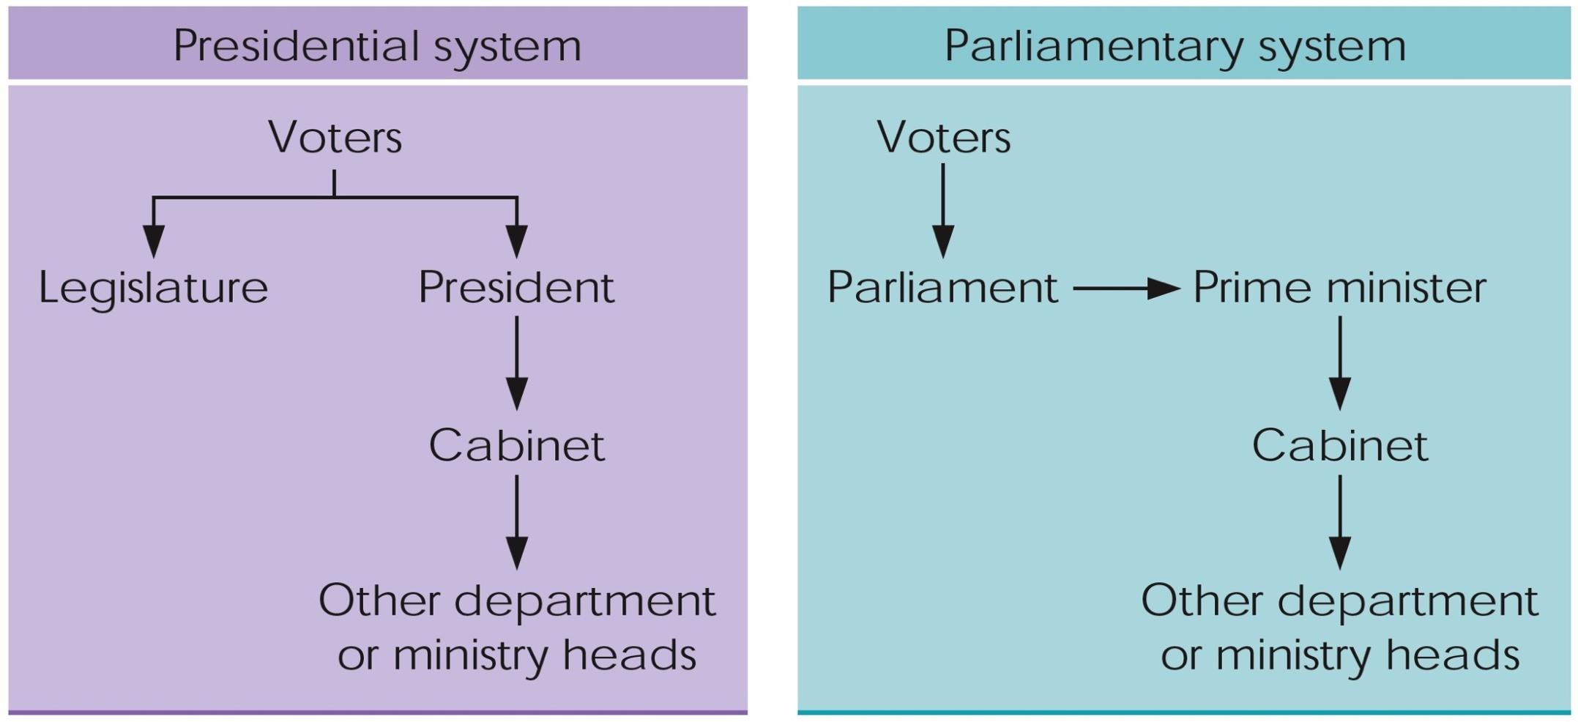
Election in Presidential and Parliamentary System

Slide 28
Based on | Presidential | Parliamentary
Relationship between Executive and Legislative | Clear Separation of power | Fusion of Power
Head of State /Government | Same Person | Different Persons
Term of Office | Fixed (Predictable) | Less Predicatable
Cabinet | From outside Legislature | Either from Legislators or outside of them
Executive’s Question Period | Irregular (primarily responsible to the people) | Regular (primarily responsible to parliament)
Government Coalitions | Less Likely | More Likely
Election of Chief-Executive | Direct | Indirect
Legislation | More Gridlock, More Independence from Party | Easier to pass Legislation, Party control more disciplined
Removal From Power | Impeachment | Vote of no confidence

Slide 29
C. Semi-presidential/Hybrid: https://www.slideshare.net/jamaity_tn/systems-of-government-semipresidential-models
This is an alternation between presidential and parliamentarian phases which solves both executive-legislative dead lock of presidential and legislature’s uncritical support of government in parliamentarianism.
Separation of power in hybrid system is not as clear as presidential and not as fused as parliamentary.

Slide 30
Major Features of the Semi-Presidential System:-
A semi-presidential system, or dual executive system, is a system of government in which a president exists alongside a prime minister and a cabinet, with the latter two responding to the legislature of the state.
It differs from a parliamentary system in that it has a popularly elected head of state who is more than a ceremonial figurehead, and from the presidential system in that the cabinet, although named by the president, responds to the legislature, which may force the cabinet to resign through a motion of no confidence.

Slide 31
2.8. The Difference between State and Government
State | Government
State is wide | Government is smaller
Abstract | Practical & concrete organization
State continue to exist | Temporary/ it changes frequently
The state is a composition of all citizen | All of the citizens are not members of government
Membership to the state is compulsory | Membership to the government is an optional matter
Are not of various kinds | Various kinds

Slide 32
Class Activities:
Discuss what is state is, its historical development and the elements of state
Discus the differences between society and state
Describe the difference between unitary, federal and confederal state structure
Discuss the division of power in federal state structure
Define what government means and identify organs of government and its functions
Describes the different systems of government and identify the main differences between parliamentary and presidential system of government
List the differences between state and government?

